Slide 1
Sturm-Liouville Problem Solution particularly important in the study of eigenvalues and eigenfunctions, which are solutions to the equation

Slide 2
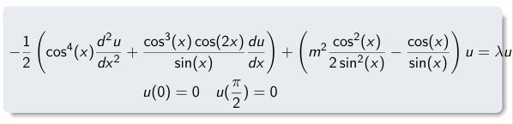
Input:
The code solves a complex Sturm-Liouville eigenvalue problem involving a second-order differential equation
with singular points at
x = 0 and π/2,
where we need to find eigenvalues λ and corresponding eigenfunctions u(x) that satisfy specific boundary conditions
with boundary conditions:
u(0) = 0
u(π/2) = 0
The task is to find the first 8 eigenvalues (λ) and their corresponding eigenfunctions.

Slide 3
Mathematical Analysis Characteristics of the Problem:
1. Singular Points:
The equation has singular points at x = 0 and x = π/2
These points require special handling in the numerical implementation
2. Form of the Equation:
Second-order differential equation
Contains both first and second derivatives
Has variable coefficients that depend on x
Contains singular terms (terms with sin(x) in denominator)
3. Parameter Dependencies:
Contains parameter m (set to 1 in our implementation)
Eigenvalue parameter λ appears linearly

Slide 4
Numerical Solution Approach
1. Domain Handling
To handle the singular points, we:
Start integration at x = 0.0001 instead of x = 0
End integration at x = π/2 - 0.0001 instead of π/2
Use dense output points (1000 points) for accurate solution representation

Slide 5
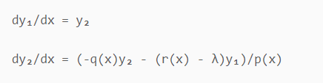
2. Equation Transformation
The second-order ODE is transformed into a system of first-order ODEs:
Let y₁ = u
Let y₂ = du/dx
This gives a system:
where:
p(x) = -0.5cos⁴(x)
q(x) = -0.5(cos³(x)cos(2x)/sin(x))
r(x) = (m²cos²(x))/(2sin²(x)) - cos(x)/sin(x)

Slide 6
Algorithm
The solution employs a shooting method combined with binary search: it transforms the second-order ODE into a system of first-order ODEs, uses numerical integration (RK45) to solve the initial value problem, and systematically searches for eigenvalues by adjusting λ until the boundary conditions are met.

Slide 7
Shooting Method Implementation
The shooting method is implemented as follows:
1. Initial Value Problem:
Start with u(0) = 0
Choose initial slope u'(0) = 1
Integrate to x = π/2

Slide 8
2. Eigenvalue Search:
Use binary search to find λ values
Target condition: u(π/2) = 0
Search interval: [λ_guess - 5, λ_guess + 5]
Convergence tolerance: 1e-z
3. Multiple Eigenvalues:
Start with λ₁ guess = 1.0
For subsequent eigenvalues: λₙ₊₁ guess = λₙ + 5
Find 8 eigenvalues and corresponding eigenfunctions

Slide 9
Numerical Integration
The IVP solver uses:
Adaptive step size control
Dense output for solution evaluation at specified points
Error Handling and Robustness
2. Convergence Controls:
Maximum iterations: 100
Tolerance: 1e-6
Binary search interval width: 10
1. Singular Point Treatment:
Minimum sin(x) threshold: 1e-10
Domain adjustment to avoid exact singular points
3. Normalization:
Eigenfunctions normalized using L2 norm
Integration using trapezoidal rule

Slide 10
Test Cases
Validation
1. Boundary Conditions:
Verify u(0) ≈ 0
Verify u(π/2) ≈ 0
Tolerance: 1e-5
2. Eigenfunction Properties:
Orthogonality between different eigenfunctions
Normalization (L2 norm ≈ 1)
3. Eigenvalue Properties:
Real values
Increasing sequence
Convergence of shooting method

Slide 11
Limitations and Considerations
Numerical Limitations
Accuracy depends on domain discretization
Sensitive to initial guesses for eigenvalues
May miss closely spaced eigenvalues
Performance Considerations
Computation time increases with number of points
Memory usage scales with number of evaluation points
Binary search may require many iterations
Stability Issues
Near singular points
For large eigenvalues
With extreme parameter values

Slide 12
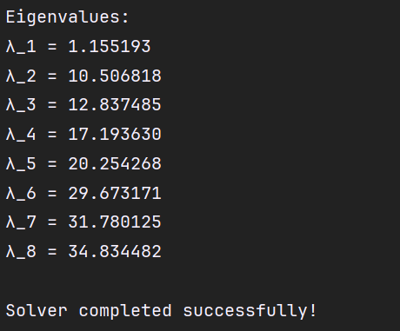
RESULTS
The results show eight distinct eigenvalues ranging from λ₁ ≈ 1.16 to λ₈ ≈ 34.83, with corresponding eigenfunctions displaying increasingly oscillatory behavior as the eigenvalue increases.
The visualization demonstrates that each eigenfunction satisfies the boundary conditions (u(0) = u(π/2) = 0) and exhibits a characteristic shape with a number of nodes (zero crossings) that increases with the eigenvalue index,
which is consistent with the theoretical expectations for Sturm-Liouville problems.

Slide 13
